Slide 1
Melanie Gray Head of Education CMC department Faculty of Media and Communications Industry competitions: embedding them in student assessment

Slide 2
Industry competitions: embedding them in student assessment

Slide 3
About you
Your interest in this area

Slide 4
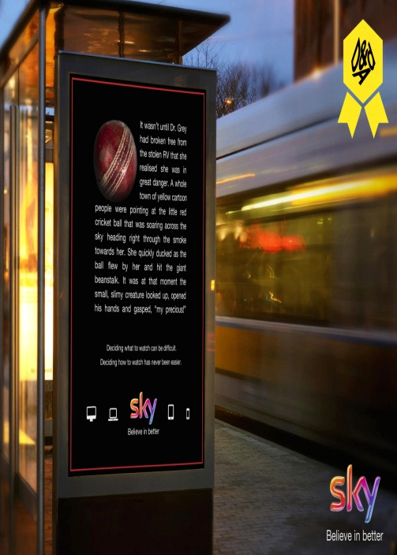
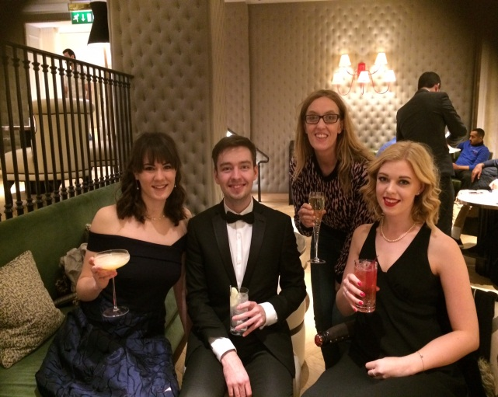
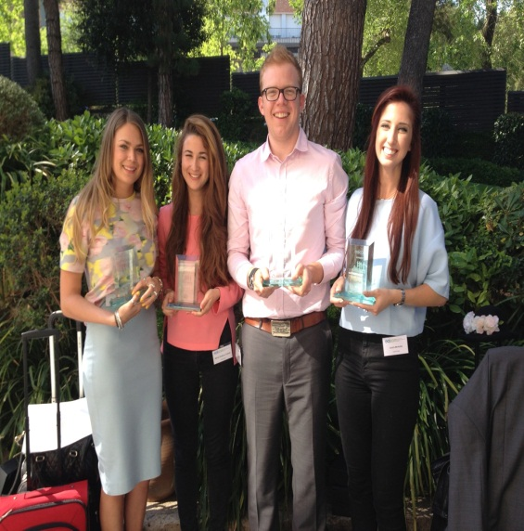
Ross Nance won Best of Year award in the 2014 D&AD New Blood Awards.
Bournemouth Advertising students scoop top student award
Team 'fellow' won the
annual EdCom student
competition!!!
90 student teams entered
2 teams from Bournemouth
reached the final
2017 finalists

Slide 5
Psychological Transformation evident in those that indicated high levels of engagement and satisfaction with the learning approach (Barnet 1997)
It was both challenging and rewarding in equal measure, allowing me to discover ambition and determination I never knew I possessed. Thank you so much for getting us involved in this

Slide 6
FINDING
In order to embed industry competitions you need to find some for your students to enter
So…how do we FIND them??
Notes:
Evidence:
208 documents with brand co-creation as search parameter – all reviewed
General co-creation literature – over 700 pieces identified, top 200 reviewed and all from 2016/17
Brand identity literature
Brand management literature from turn of 20th century
Body of literature exists across these constructs, some more newly developed (brand co-creation) others with a longer history (brand management and brand identity) however, very limited exploration into how the constructs interplay and particularly in the context of the media industry. See recent work of Nando Malmelin and Mikko villi (2017) looking at co-creation in the context of magazine media brands, and the work of Anna Viljakainen and Marja Toivonen (2014) again in the magazine publishing area.

Slide 7
MATCHING
We need to ensure any competitions we embed fit with our teaching aims
Notes:
Evidence:
208 documents with brand co-creation as search parameter – all reviewed
General co-creation literature – over 700 pieces identified, top 200 reviewed and all from 2016/17
Brand identity literature
Brand management literature from turn of 20th century
Body of literature exists across these constructs, some more newly developed (brand co-creation) others with a longer history (brand management and brand identity) however, very limited exploration into how the constructs interplay and particularly in the context of the media industry. See recent work of Nando Malmelin and Mikko villi (2017) looking at co-creation in the context of magazine media brands, and the work of Anna Viljakainen and Marja Toivonen (2014) again in the magazine publishing area.

Slide 8
MATCHING
Level 8 (PhD)
Create, Innovate and Inspire
Level 7 (Master)
Master
Level 6 (UG)
Critque and Specialise
Level P (Placement)
Contextualise
Level 5 (UG)
Extend/Appy
Level 4 (UG)
Know/Understand
-Programme scope
-UNIT AIM
-ILOs

Slide 9
EXACTING
To ensure success it needs to work for both students and staff
HOW?....overcoming issues and tensions

Slide 10
A combination of competitive and collaborative learning provides high levels of performance, motivation and a greater student engagement. (Tauer & Harackiewicz 2004).
Competition and its use within learning can be seen as an effective way to motivate and increase student satisfaction (L Regueras et al 2008).
It really motivated us to get involved in a competition.
We all wanted to do well.
It was brilliant to see our work having real relevance.

Slide 11
Further exploration
Further research
Future workshops and support
Notes:
Qua

Slide 12
Melanie Gray mgray@bournemouth.ac.uk
Thank you

