Slide 1
Guide for students

Slide 2
What do we do?
Services available up to 3 years after graduation
Careers
Education, Information, Advice and Guidance
CEIAG
Employer Events
Job Shop
Part-time, placement and graduate vacancies
Student Development Award
MyCareerHub
Information resources
Notes:
The Career and Employability Team offers information, advice and guidance regarding career choices and career planning, recruitment, skills development and career opportunities to enable students to explore, develop and realise their career potential. We actively engage students in programmes of relevant, up-to-date employability curricula and
extra curricula activities. We work with academic faculty communities as well as networks of employers, community organisations and career professionals. The service supports students to reflect on their learning and development and to articulate themselves effectively to employers.

Slide 3
Some examples of careers help
How to make yourself employable
Strategies for finding work in the UK & overseas
How to market yourself via CVs, covering letters, application forms
How to succeed at interviews, assessment centres
Career & job options with your degree
Graduate schemes
How to use of social media to find work e.g. LinkedIn
How to create a personal brand to market yourself to employers
Understanding commercial awareness in the interview process
Strategies for successful networking
Graduate starting salaries/earnings
How to disclose a disability in the job application process
How to identify your employability skills
Postgraduate study options in the UK & overseas
Deciding what to do after university
Advice if you are considering changing or leaving your course
Interview techniques

Slide 4
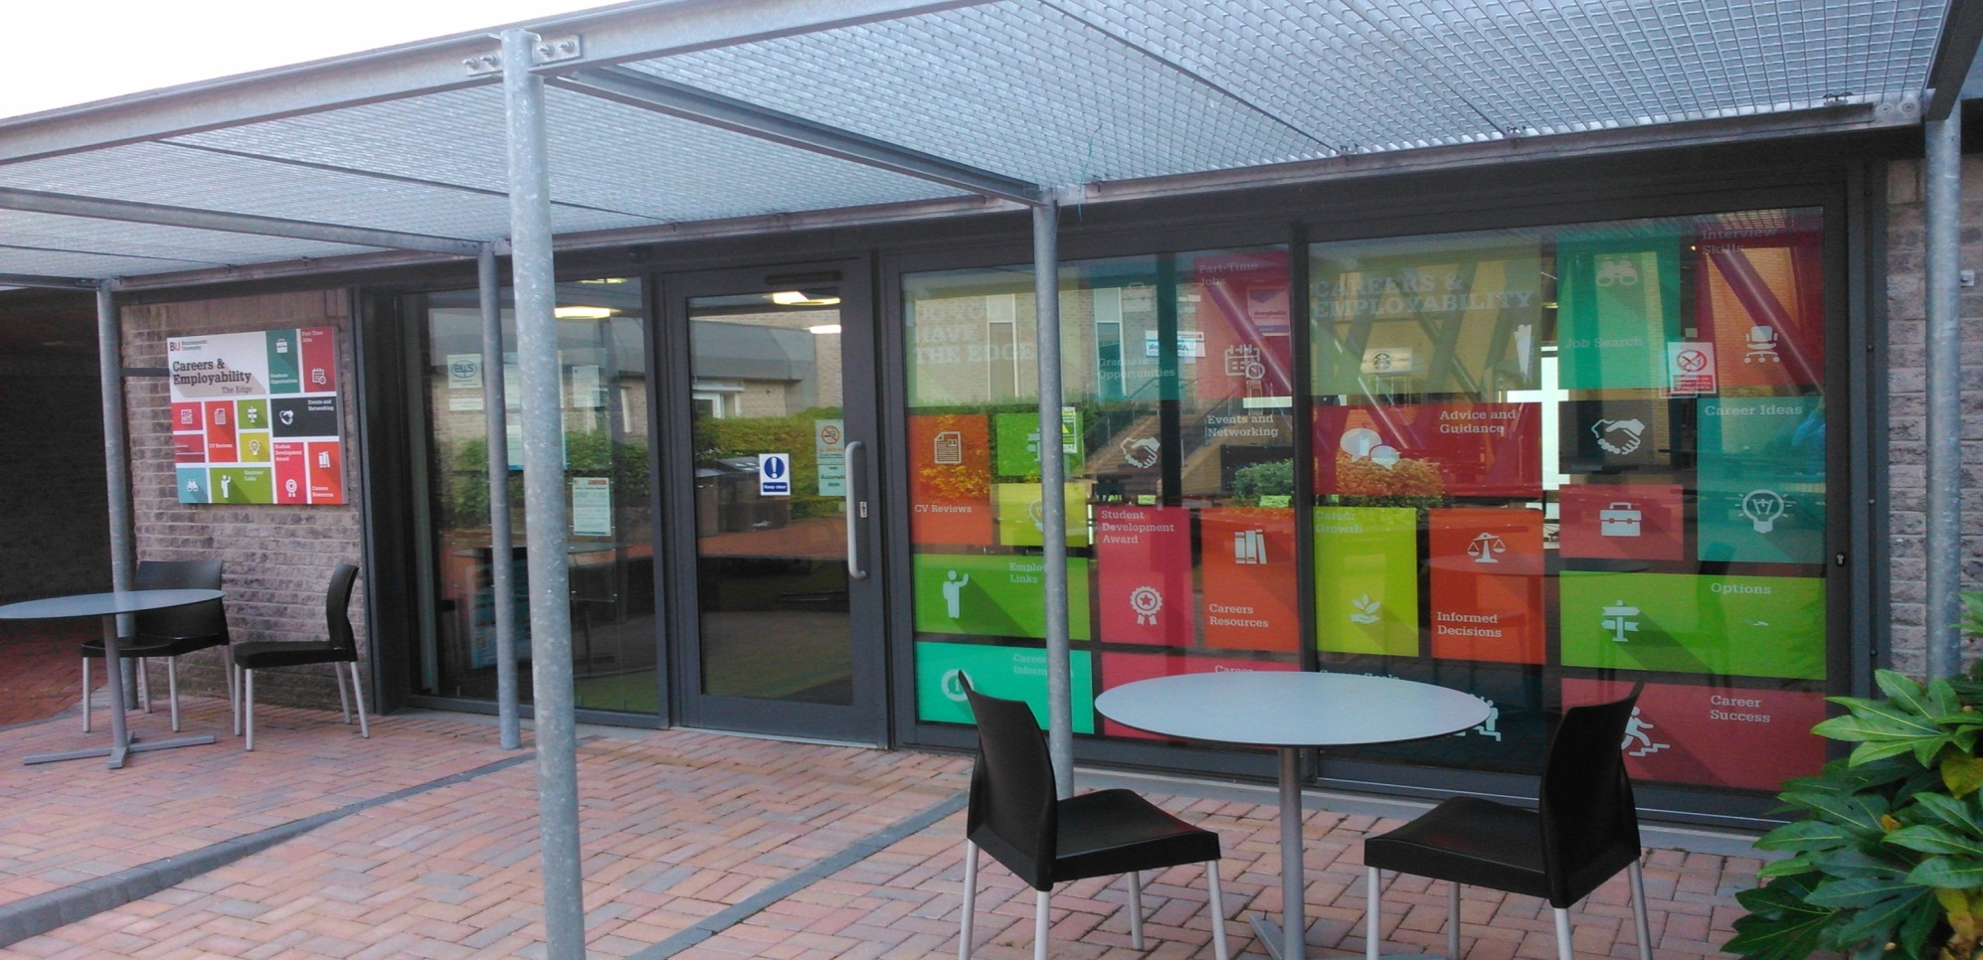
Where - The Edge
Student drop in centre opposite Library Talbot Campus
https://twitter.com/BUcareersweb
: http://mycareerhub.bournemouth.ac.uk
( 01202 961663
Open 8.45am – 4:30pm Monday to Friday
http://mycareerhub.bournemouth.ac.uk
Notes:
https://twitter.com/Bucareersweb
One stop shop for all your careers information needs
- face to face appointments
- email enquiries
- “how to…” guides & resources
- jobs
- employer events
- drop in enquiries – the edge

Slide 5
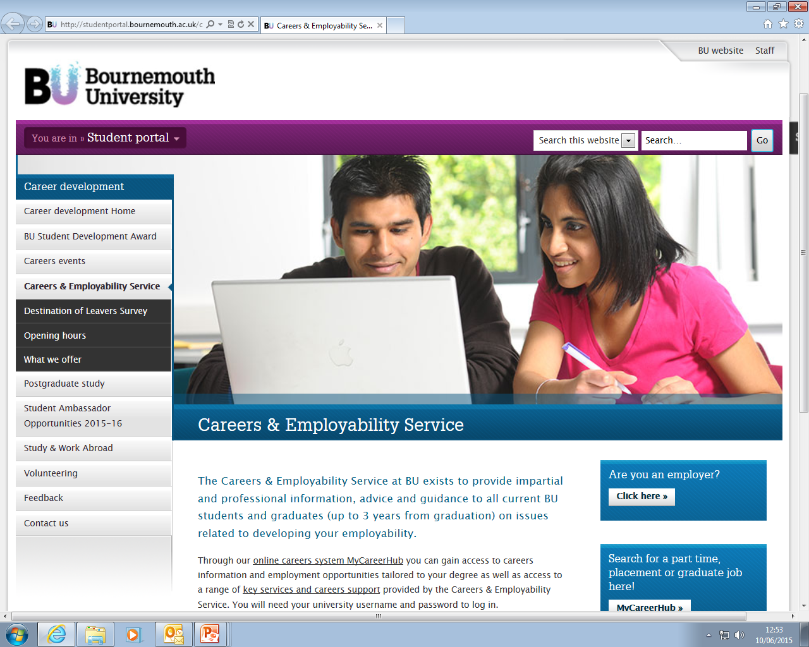
Where - C&E Homepage

Slide 6
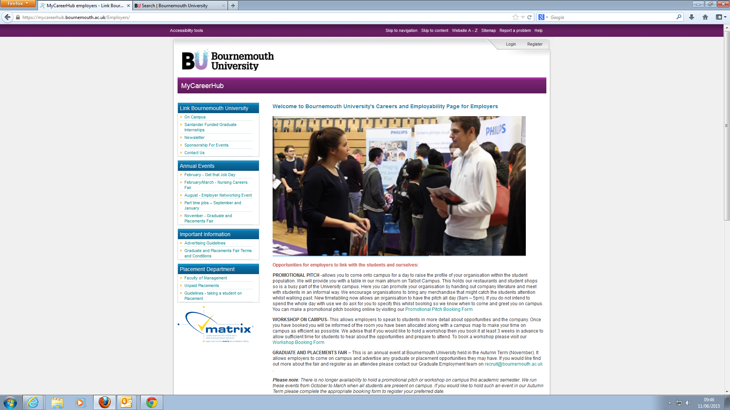
www.bournemouth.ac.uk/mycareerhub
Where - Work with Employers

Slide 7
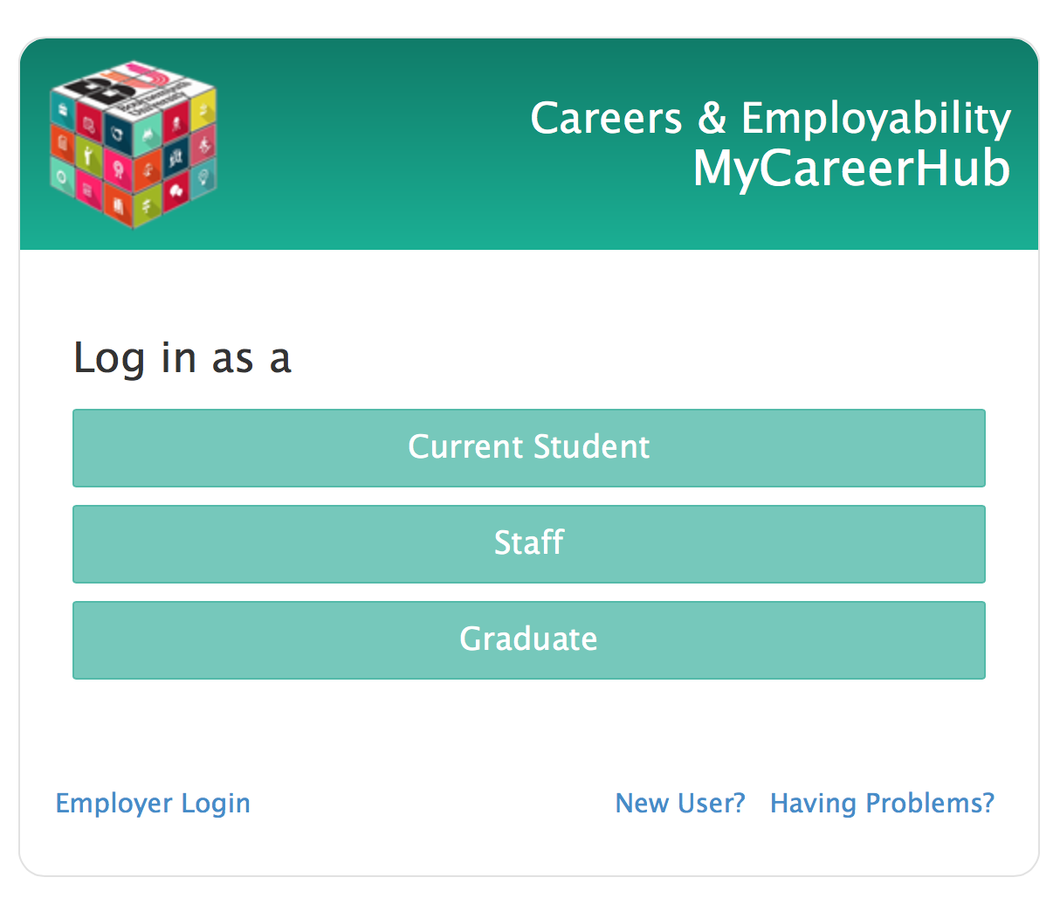
What you need to know:
http://mycareerhub.bournemouth.ac.uk
Use your usual BU student login details to register and use the site

Slide 8
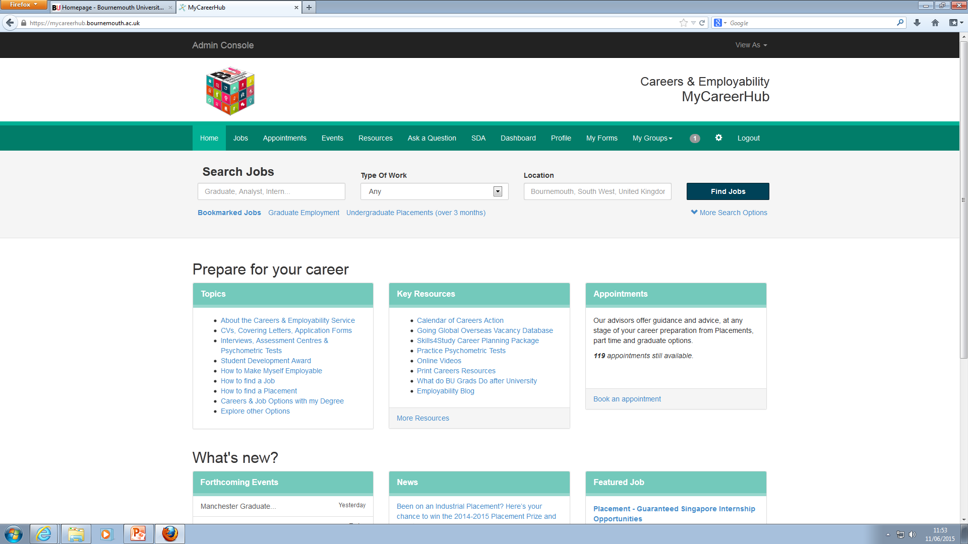
How it works

Slide 9
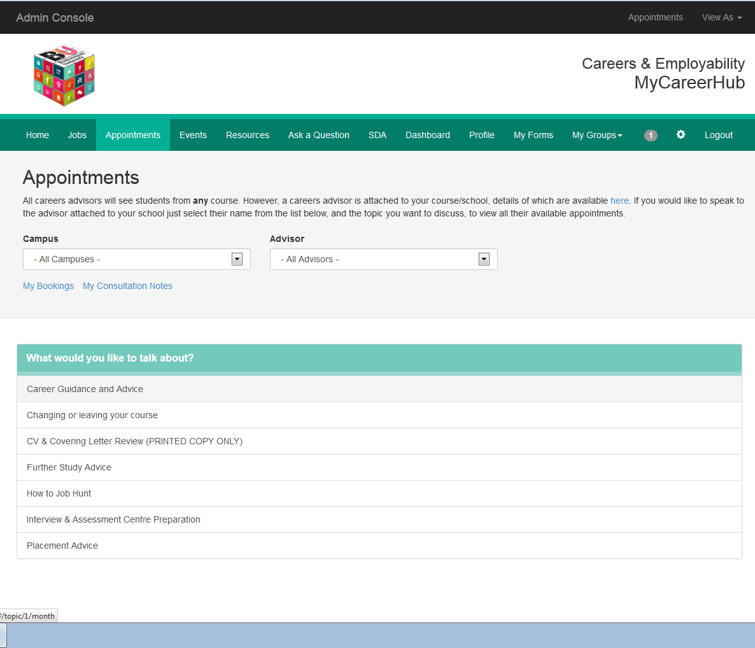
Careers Appointments

Slide 10
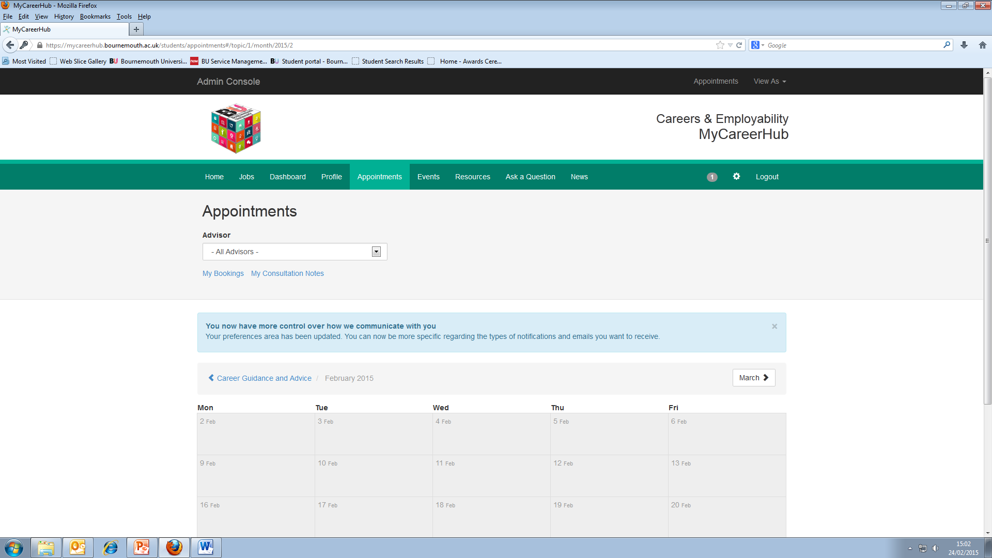
Careers Appointments
Book on MyCareerHub or Call 01202 961663
http://mycareerhub.bournemouth.ac.uk
Notes:
Confidential & impartial advice and guidance on any careers related matter
Careers support during your time at BU and up to 3 years after graduating.

Slide 11
Stand out from the crowd
Improve your employability skills from the
extra-curricular activities you enjoy
Find out more at
https://www1.bournemouth.ac.uk/students/careers/bu-student-development-award
Watch at
https://youtu.be/C13Gw_3Vgjk

Slide 12
How the Award Works
www.bournemouth.ac.uk/student/award

Slide 13
What we offer
Careers appointments (face to face, telephone, skype)
Practice Psychometric Tests for Free: Profiling for Success
Participate in Employer events & Skills Workshops
Network with graduate employers at the Graduate and Placements Fair
Find and apply for jobs via the Job Shop
Student Development Award
7. Careers Resources
Employability Blog – Sign up to the RSS feed to keep informed of new items being posted!
BU Careers Twitter Page
Book loans in the Edge
Online resources on MCH
8. 'Ask us a Question' Service
http://mycareerhub.bournemouth.ac.uk
Notes:
Confidential & impartial advice and guidance on any careers related matter
Careers support during your time at BU and up to 3 years after you have left

Slide 14
Useful contacts /more information
http://mycareerhub.bournemouth.ac.uk
Link to staff intranet
https://twitter.com/BUcareersweb
For career enquiries
For employer enquiries
careers@bournemouth.ac.uk recruit@bournemouth.ac.uk
( 61663 ( 61660

